Slide 1
DATA 621 - Business Analytics and Data Mining
Predicting the number of YouTube views using linear regression
Fall 2020 - Group 2 - Final Project
Authors: Avraham Adler, Samantha Deokinanan, Amber Ferger, John Kellogg, Bryan Persaud, Jeff Shamp

Slide 2
Abstract
Method
Attempted to predict number of views
Used criteria including category, number of likes, number of dislikes, and number of comments
Engineered features based in ratios of predictors
Used linear regression to test for predictive power
Results
Allow ratings and posts which will engender heated discussion.
Keywords
Youtube, linear regression, elastic net, R

Slide 3
Introduction
YouTube has changed the future of video entertainment
YouTube’s model connects a user’s creativity with a desire for global recognition
Creators from all over the world gain international prominence using their own equipment and space
Online video platforms are taking over the entertainment world.
6 out of 10 people already prefer online video platforms or streaming services over live TV
Expected in four years—half of viewers under the age of 32 will not pay TV service
Understanding this world is beneficial to many people and companies

Slide 4
Literature Review
This problem has been addressed often. For example:
S. Ouyang, C. Li, and X. Li, “A Peek Into the Future: Predicting the Popularity of Online Videos,” IEEE Access, vol. 4, pp. 3026–3033, June 14, 2016, doi: 10.1109/ACCESS.2016.2580911.
H. Pinto, J. M. Almeida, and M. A. Gonçalves, “Using Early View Patterns to Predict the Popularity of Youtube Videos,” in Proceedings of the Sixth ACM International Conference on Web Search and Data Mining, Rome, Italy, 2013, pp. 365–374, doi: 10.1145/2433396.2433443.
T. Trzciński and P. Rokita, “Predicting Popularity of Online Videos Using Support Vector Regression,” Ieee Transactions on Multimedia, vol. 19, no. 11, Art. no. 11, April 18, 2017, doi: 10.1109/TMM.2017.2695439.
A. Srinivasan, “Youtube Views Predictor,” December 12, 2017. https://towardsdatascience.com/youtube-views-predictor-9ec573090acb.

Slide 5
Methodology
Data for this project is from Kaggle.
Data roadblocks:
Data appeared to be broken up by country.
Actually, country seems to be just location of count capture
Most videos had same statistics on same days across countries
United States had the most observations so it was selected
Feature selection
Explored relationships between a views and number of likes, dislikes, and comments
Used video category and properties as factor features
Engineered ratio features
Used linear regression to investigate relationship between features and views
Models compared using RMSE, R², and MAE

Slide 6
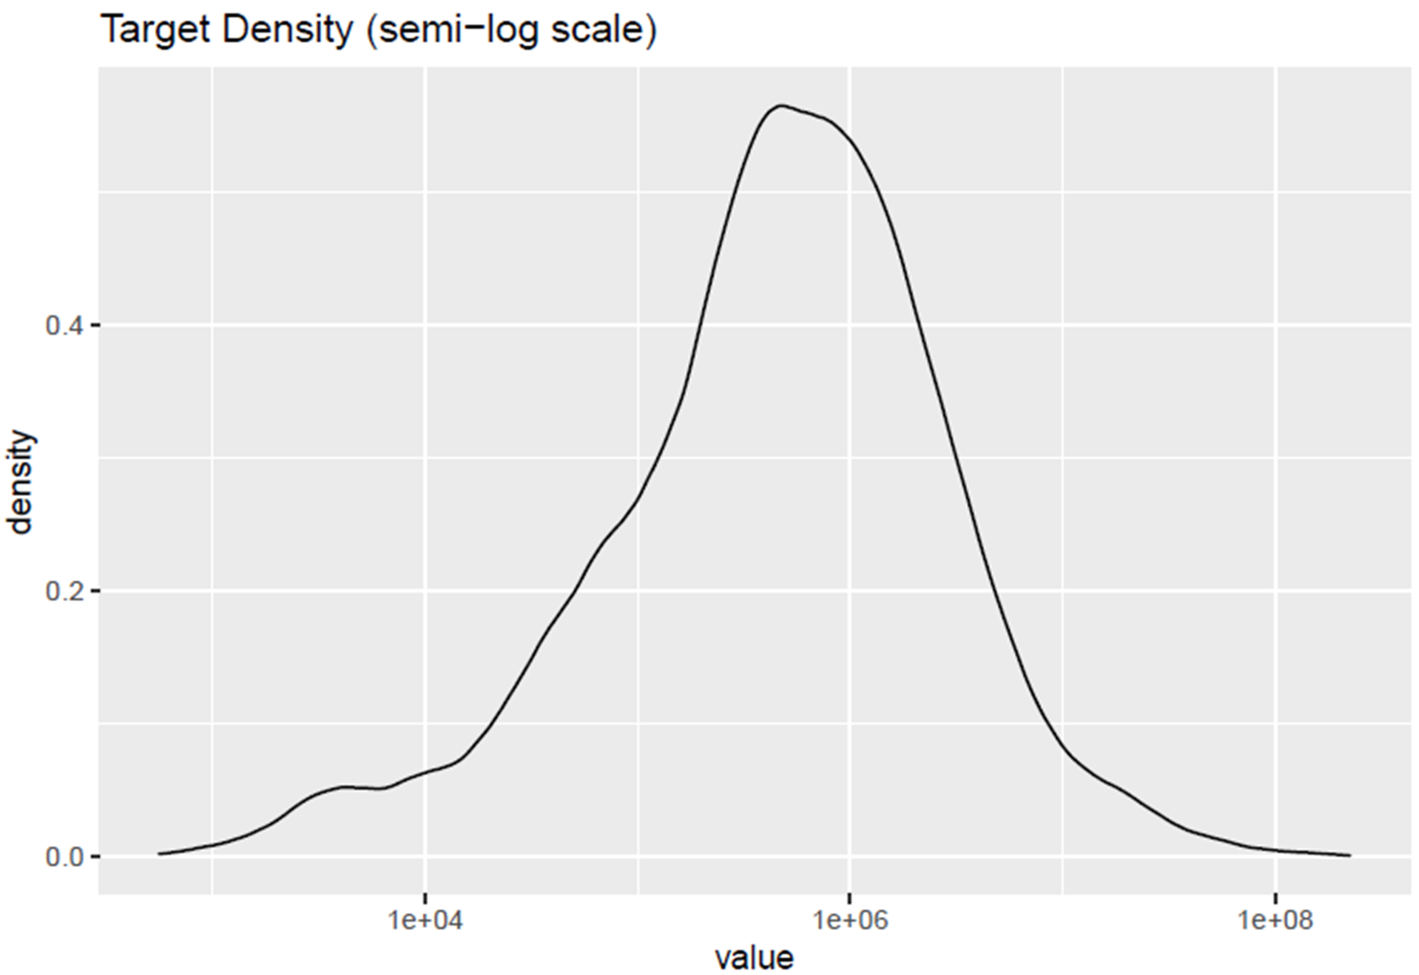
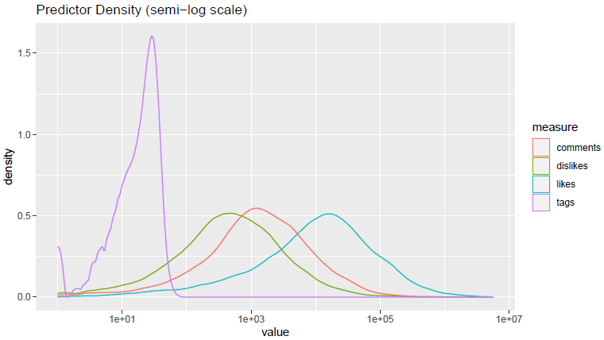
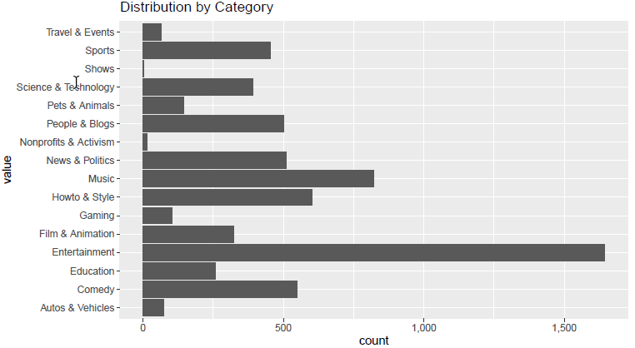
Data Exploration
Target Variable
Target Variable: Views
On log scale looks Gaussian implying lognormal distribution.
Numeric Predictors
Number of tags is orders of magnitude less than rating or comment variables
More likes than comments, More comments then dislikes
All three exhibit symmetric Gaussian-like behavior
Categories
Interests Vary by Category
In the US
1st is Entertainment
2nd is Music
Numeric Predictors
Categories

Slide 7
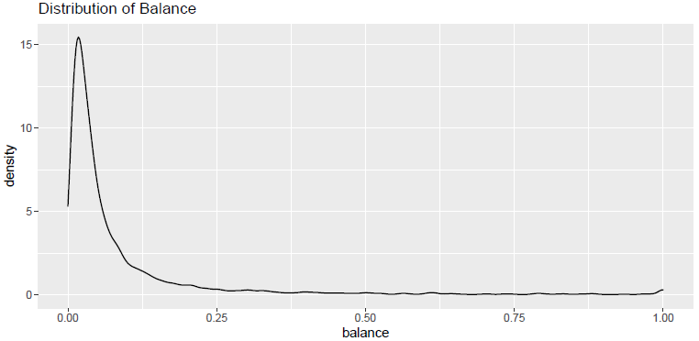
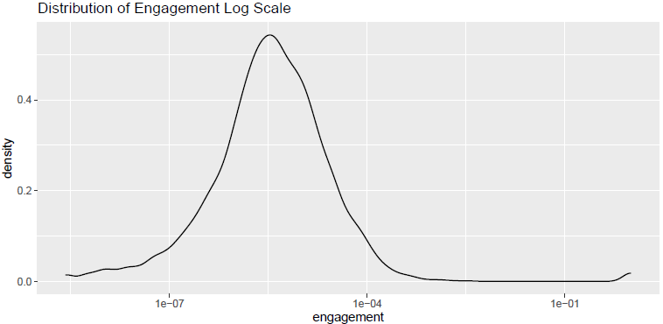
Feature Selection & Engineering
Feature Selection—Relationship of views to:
Likes, dislikes, comments, and tags
Category
Disabling comments or ratings
Error with the video
Feature Engineering—Hypothesize that if video is universally loved or panned it will get fewer views
Balance: ratio between likes and dislikes
Engagement: ratio of comments to sum of likes and dislikes
It’s pretty clear from the distribution of balance that, at least for videos viewed in the US, there is a healthy dose of disagreement!

Slide 8
Models
Investigated four models in three families:
Model 1: Ordinary Least Squares
Equivalent to GLM with Gaussian errors and inditiy link function
Model 2a & 2b: GLM with log link function
Model 2a: Gaussian Errors
Model 2b: Poisson Errors
More appropriate for counts in general
Model 3: Penalized Regression
Elastic Net Model
Combines best features of Lasso and Ridge regression
Details may be found in corresponding paper
Investigated multiple models in linear regression family

Slide 9
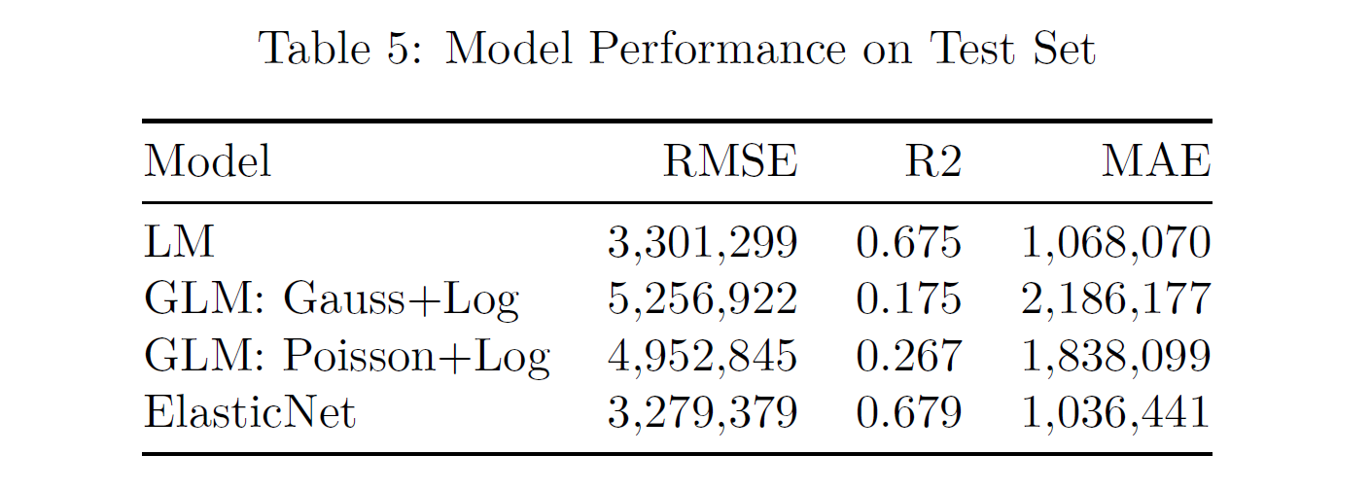
Model Evaluation
The three models contain both intuitive and counter-intuitive results.
As expected, videos with more ratings tend to have more views.
However, as likes outnumber dislikes, that tends to reduce the number of views.
All the models agree that having a video whose likes and dislikes are close in magnitude increases the propensity for views.
ElasticNet model performed best
Clearly the log link is inferior to the identity link for this data set

Slide 10
Conclusions
Make sure videos will engender heated discussions
Get as many dislikes as likes
Keep ratings enabled.
Allowing users to rate your video drives attention to them
Investigate potentially disabling comments.
Stay away from activism.
Talk about films or comics.
Probably reflects the anime and manga phenomena.
Talk about cars
More tags is better

Slide 11
Future Development
Investigating more sophisticated algorithms
Analyzing growth patterns over time
Finding better sources or methods to include country without overcounting

Slide 12
Questions?
Thank you for making the time to view our presentation and our findings.

